Slide 1
ACC 200:
Surrounded by Multitudes,
Focused on the One

Slide 2
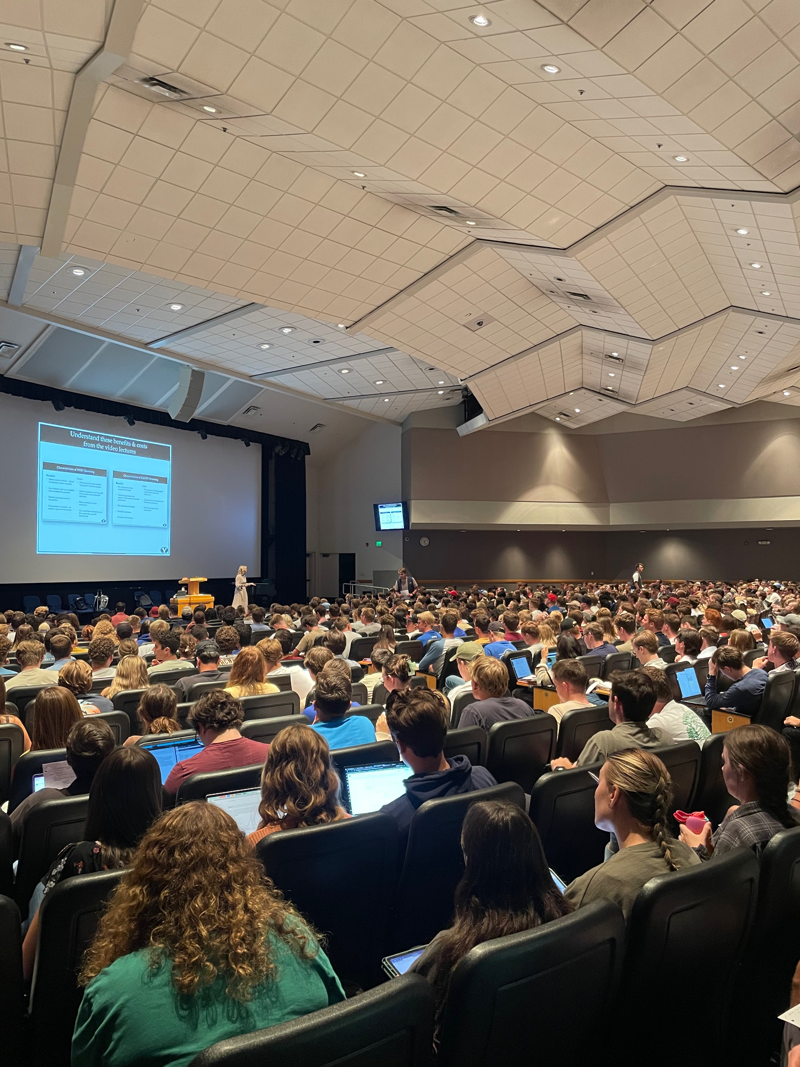
Some quick background…
10+ years
Accounting program
Average class size 55
ACC 200
Large enrollment
Interested in accounting??

Slide 3
Accounting 200
Accounting is __________________.

Slide 4
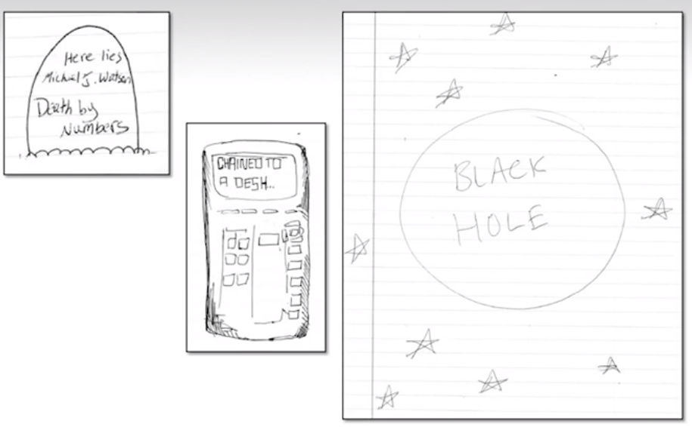
What would a picture of accounting look like?

Slide 5
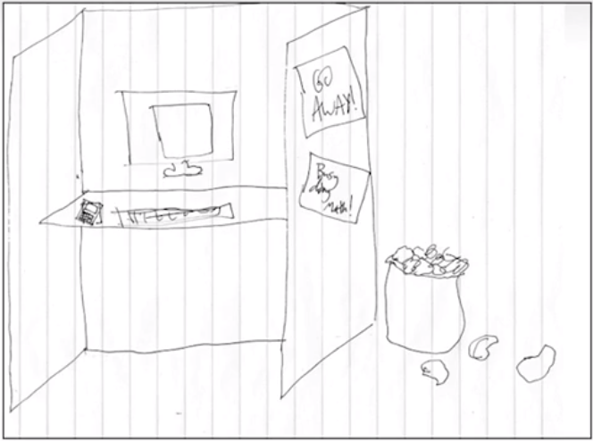

Slide 6


Slide 7
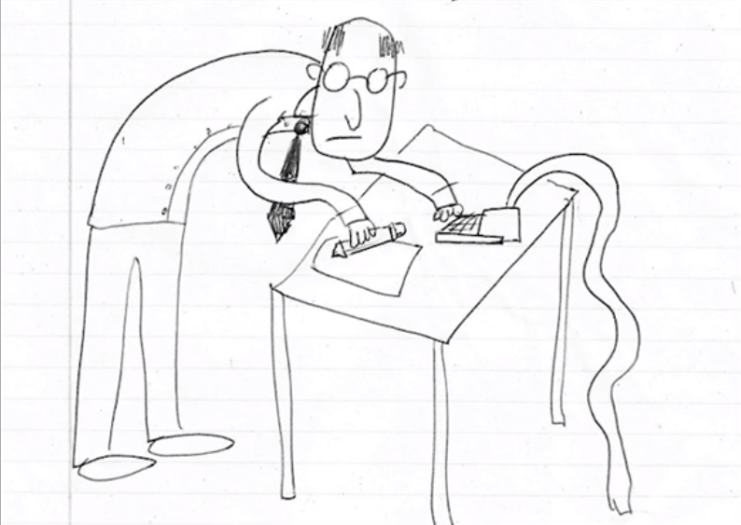

Slide 8
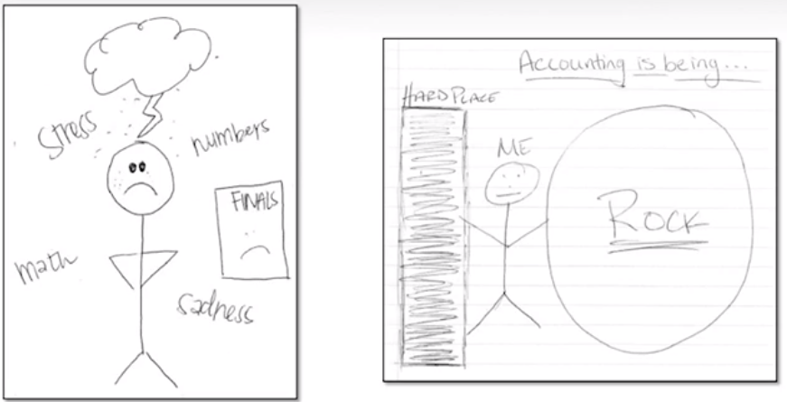

Slide 9
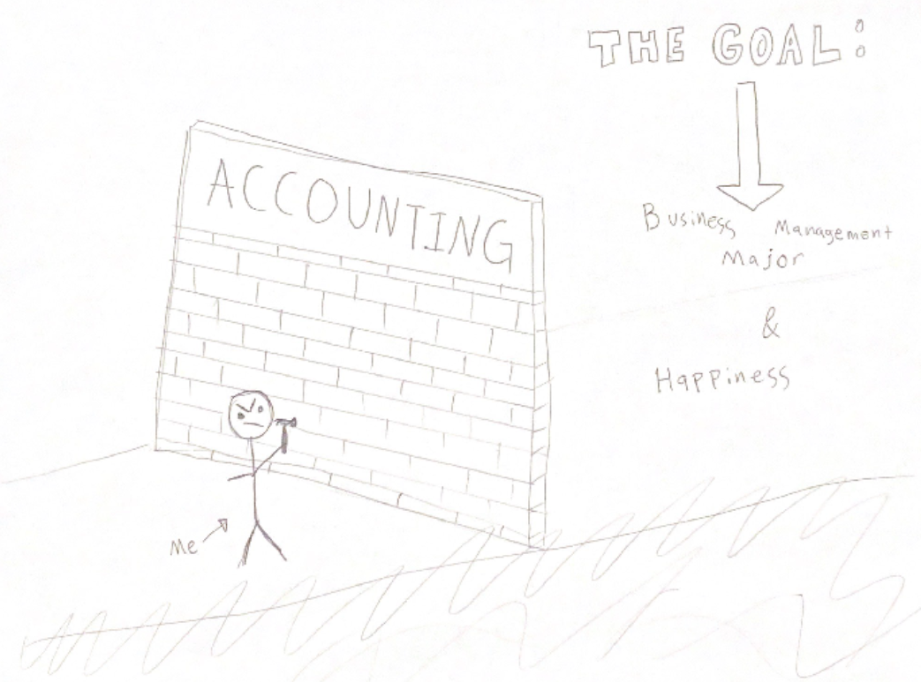

Slide 10

We were ALL feeling
Pressure
Stress
Uncertainty
Fear

Slide 11
“Jesus Christ is our greatest example. He was surrounded by multitudes and spoke to thousands, yet He always had concern for the one. We are to be our brother’s keeper. We must be concerned for the one.”
Elder Joseph B. Wirthlin
Concern for the One
April 2008

Slide 12
Every element of course design, every piece of content delivered, every message I send, and every interaction I have with students in ACC 200 is going to be intentional and purposeful—tailored to serve the multitude while still being watchful and mindful of the one.

Slide 13
Reduce the DEW rate
First week of class
  ACC 200 lab open house with professors + TAs + food
  First-gen student lunch where exam reviews are held
  Meeting with student athletes in the SAC
Proactive outreach to students with accommodations
Flexible help: In-person drop-in TA lab, remote drop-in TA lab, custom ACC 200 chatbot available 24/7
Many low stakes weekly quizzes with unlimited attempts to get a perfect score to encourage students to spread study over the entire semester
Leverage the LMS to encourage and support students
Exam retake option

Slide 14
Second (and Third) Chance Exam Policy (SCEP)
For one week following each exam, students are allowed to retake an exam up to two additional times with a cap of 80% on second and third attempts.
Second and third attempts of the exam are not the same exam, but covers the same concepts.

Slide 15
Results of a SCEP
On average, students
Performed better in the course
Performed better on their first attempt of the exam
Gender interaction, females benefitted more, reducing the gender gap

Slide 16
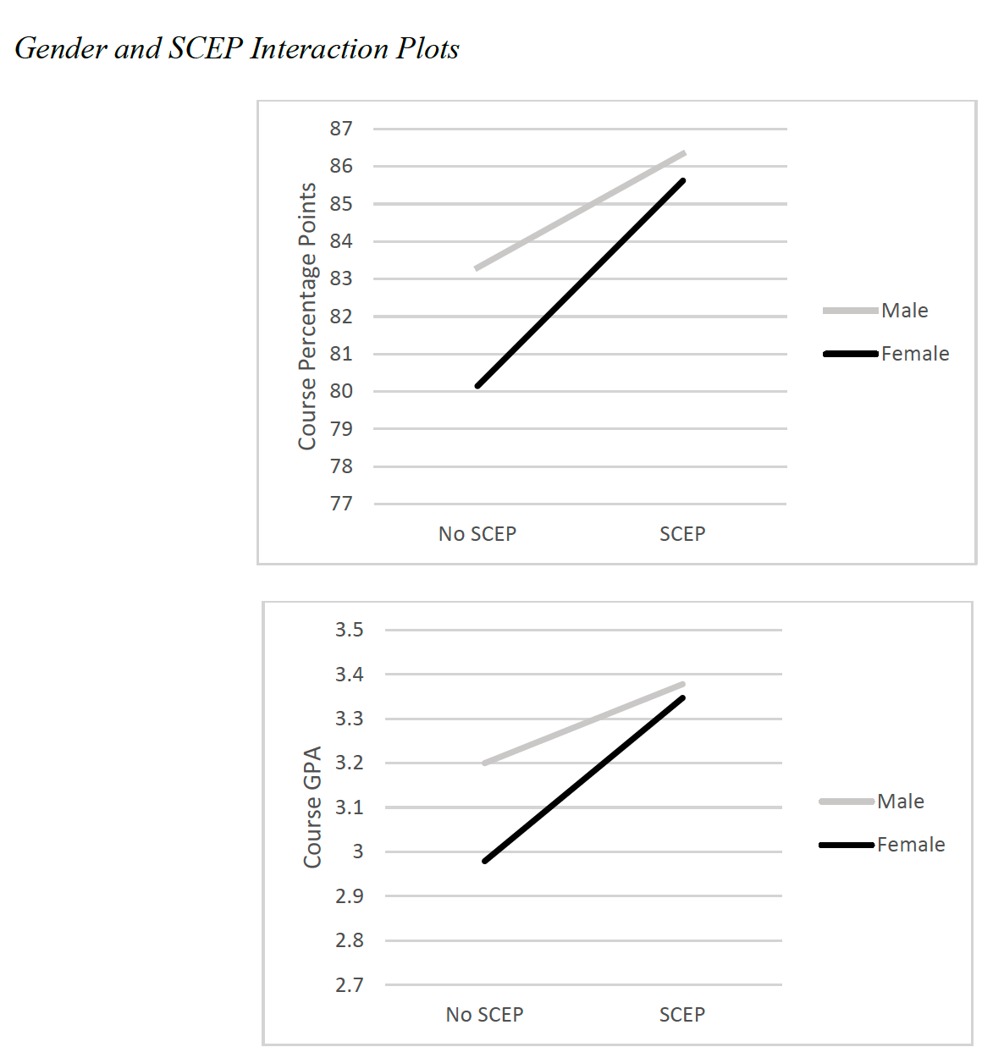

Slide 17
Student Example
Student 1 | Attempt 1 | Attempt 2
Exam 1 | 20% | 55%
Exam 2 | 70% | 83% (capped at 80%)
Exam 3 | 65%
Grade without SCEP | C+
Grade with SCEP | B

Slide 18
Student Example
Student 2 | Attempt 1 | Attempt 2 | Attempt 3
Exam 1 | 20% | 45% | 45%
Exam 2 | 51% | 65% | 86% (capped at 80%)
Exam 3 | 51% | 59% | 63%
Grade without SCEP | D+
Grade with SCEP | B-

Slide 19
Student Comments - SCEP
“I’m truly grateful for the policy because I feel like I am learning the material better.”
“I never took a second-chance exam, but it was helpful to know I could try again. It relieved some stress from taking the first test!”
”It gave me confidence that if I failed the test, I had another chance.
”It gave me hope for the semester”

Slide 20
Reduce the DEW rate
First week of class
  ACC 200 lab open house with professors + TAs + food
  First-gen student lunch where exam reviews are held
  Meeting with student athletes in the SAC
Proactive outreach to students with accommodations
Flexible help: In-person drop-in TA lab, remote drop-in TA lab, custom ACC 200 chatbot available 24/7
Many low stakes weekly quizzes with unlimited attempts to get a perfect score to encourage students to spread study over the entire semester
Leverage the LMS to encourage and support students
Exam retake option

Slide 21
Enrollment is Up

Slide 22
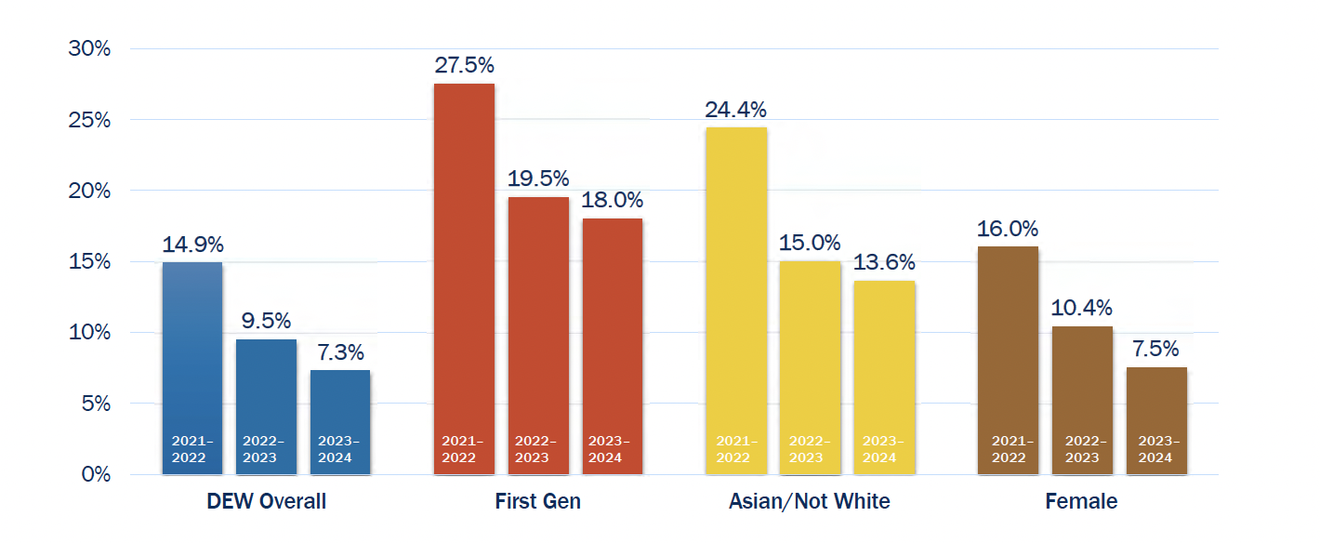
DEW Rates are Down

Slide 23
Alma 26:37
“We see that God is mindful of every people, whatsoever land [or major] they may be in; yea, he numbereth his people, and his bowels of mercy are over all the earth. Now this is my joy, and my great thanksgiving; yea, and I will give thanks unto my God forever. Amen.
Notes:
Not just to pass my class—but to get a good grade in my class. Keith Vorkink an associate dean at the time, called me into his office and first asked me what do you think we could do to reduce the DEW rate in ACC 200? They need more support and confidence

